Slide 1
OBD Manual
Personal Bibliographic Database
Based on Presentation by Mgr. Michala Sošková (FSV UK Administrator of Publishing Activities)
Modified and updated in February 2023 for IMS internal use by Bc. Jan Arlt and Mgr. Jakub Šindelář

Slide 2
OBD = System to register your publications
Access to OBD is available to employees with 0,5 FTE and more, agreement to perform a job, M.A. and Ph.D. students
Annually, university has to report into the national RIV system (Index of information on the results of science and research)
The number of entries in the RIV system results into the amount funding for the reasearch of our university
Annual Collection of Results Deadline
The collection of entries into the OBD system takes place continuously within annual intervals ending with the announced deadline (usually mid-February)
Publication entries submitted after deadline are included in the following year's data collection batch

Slide 3
Regulations + responsibilities
Measures of the Rector of the CUNI No. 40/2021
Every author creating an entry in OBD is responsible for:
-> the completeness, correctness and truthfulness of the data in the record of the result forming its complete bibliographic description
-> link to funding source (results going to RIV)
- GAČR, TAČR, GAUK, Specifical research…
- Institutional program – Cooperatio
-> and inclusion in the internal classification of fields (results going to RIV)
- Area studies
- History + subfield = Modern and Contemporary History

Slide 4
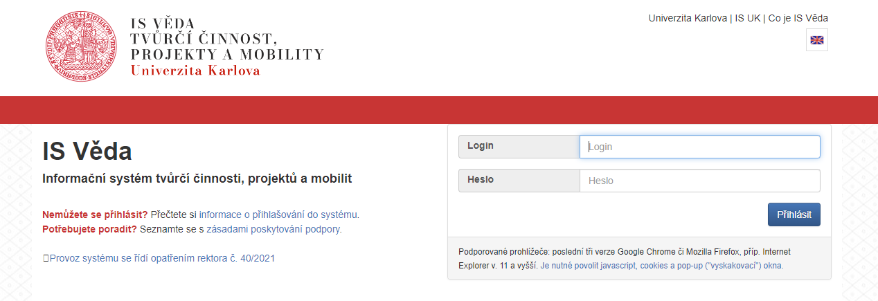
Accessing OBD
https://login-veda.is.cuni.cz/
Step 1) login to IS Věda using your SIS login and password

Slide 5
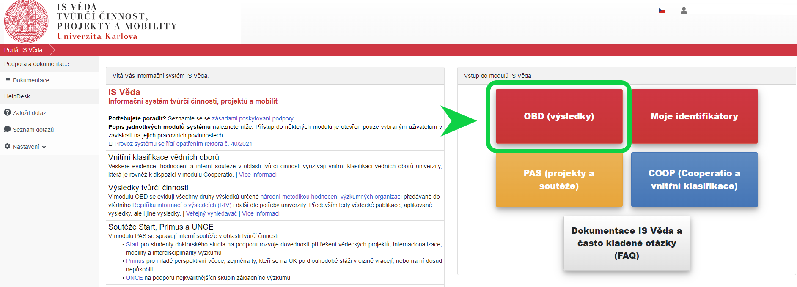
Accessing OBD
Step 2) enter the OBD system

Slide 6
Accessing OBD
Step 3) re-enter the OBD system for a second time
(now you can also switch the system into English version – see the British flag in the right upper corner)

Slide 7
Creation of new entry into OBD
Some results are partially pre-imported from SCOPUS and WoS databases and do not have to be created from scratch
Step 4) click on New record and start filling all the information

Slide 8
Affiliation
Principle: 1 research result = 1 OBD entry
every publication can be entered into OBD system only once
therefore, if there is for example a collective monography – only one author will entre it into OBD system and there she/he will mention all of his colleague
Affiliation
each result may only be recorded for the author's employment or study relationship, which is related to his educational and/or creative activity at the university and within which it was created
Worklpace in charge
the entry ´belongs´ to the original/first faculty/department of main/first author
or to the faculty/department from most of the authors are from

Slide 9
Authors
Internal authors
always enter all
to enter the authors use always the internal list
click on the small blue/white symbol ----------------------------- >
look for the name of the author or his ORCID ID
External authors
enter a maximum of 5 if they are in the first 5 places
mental share = share of co-authorship as a 0% to 100% for all authors

Slide 10
Funding method
GAČR, TAČR, GAUK
look for the project using the name of the principal investigator
Specific Higher Education Research project
read the Director‘s decree
look for the project using the name of our director doc. PhDr.Tomáš Nigrin. Ph.D.
Institutional program – Cooperatio
in case your publication was not a part of any project or you are not a MA or PhD student, enter as a funding source the institutional program Cooperatio
look for the code COOP

Slide 11
Record classification
All employees and PhD student have to always choose their primary record classification based on their study program or research focus
Area studies
History + subfield = Modern and Contemporary History

Slide 12
State of publication
Online first / Early access / Early view
Although an article (or book) has been accepted by the editors for publication, it often takes a very long time (a year, two, often more) before it is included in a standard journal issue
At that point, the result is either under review or in print (accepted for publication)
It is often released on the publisher's website in an online version before it is officially released
Preprint
The version of the article published before the review process
!!! These types of articles CANNOT yet be submitted to RIV - they can only be saved as „Draft" in OBD -> to be completed later when published fully !!!

Slide 13
Most common types of publications
These types are sent to RIV
Everything that is checked to be sent to RIV – must be registered in OBD
These kinds of results are always peer-reviewed
Journal article (type J)
Paper in conference proceedings (type D)
Book (type B)
Chapter in a book (type C)
!!! Be aware that you can always enter only either book or separated chapters. Never duplicate the entry!!!

Slide 14
,,Draft“ in OBD
Under review/In print
Although an article/book etc. has been accepted by the editors for publication, it often takes a very long time (a year, two, more…) before it is included in a standard journal issue.
At that point, the result is either under review or in print (accepted for publication
Preprint
The version of the article published before the review process
!!! These types of article CANNOT yet be submitted to RIV – they can only be saved as ,,DRAFT“ in OBD !!!

Slide 15
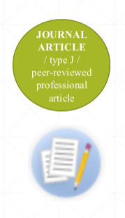
Journal article (type J)
= Peer-reviewed profesional article
Designation in OBD - Original article x Overview article
Min. 2 pages without ads, images, etc.
A professional periodical is a peer-reviewed scientific journal, with a scientific editorial staff, which is published or was published periodically, is assigned only the ISSN code, or e-ISSN and is published in print, in print and electronic or only in electronic form, including online publication.

Slide 16
Journal Article (type J) – to be continued
Definition: „An original or overview article published in a professional periodical which presents the original research results and which was carried out by the author or a team of which the author was a member and the affiliation stated by him refers to a Czech research organization. These are comprehensive texts of works with a breakdown according to the requirements of periodical publishers on the structure of a scientific work (most often summary, introduction, material and methods, results, discussion, conclusion, literature review) with the usual way of citing sources, possibly with a note-taking apparatus.“

Slide 17
Book (type B)
One of those types…
Monography
Collective monograpy
Science encyclopedia
Scientific dictionary
By definition, it´s an original research results that were carried out by the author of the book or the author's team of which the author was a member. It concerns a precisely defined problem of a certain scientific field, contains the formulation of an identifiable and scientifically recognized methodology.

Slide 18
Book (type B) – requirements
At least 50 printed pages of its own text without photographic, image, map, etc. appendices
Reviewed-externally (at least one generally recognized expert from the relevant field but not from the workplace of the book's authors
Use and references to the literature in the text
Summary in at least one world language.
Even if the individual chapters of the book have independent authorship
registered as single collective of authors .

Slide 19
Chapter in a book (type C)
One of those types…
1) Chapter in a monography (if the monography meets the type B result definition) 2) Chapter in a collective monography 3) Entry in a scientific encyclopedia 4) Entry in the scientific dictionary

Slide 20
Chapter in book (typu C) – to be continued
!WARNING!
If a professional book is registered as a type of B result, its chapters cannot be included as a type C results in the case of the same submitter of the result!

Slide 21
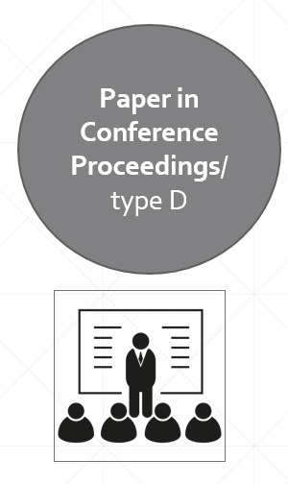
Paper in Conference Proceedings (type D)
An anthology is a peer-reviewed non-periodical publication, published on the occasion of an organized conference, seminar or symposium, hundreds of different authors, usually is assigned an ISBN or ISSN code, or both of these codes.
„Article in anthology“ presents the original results. Paper has the usual structure of a scientific paper (charakteristics) with the ususal way of referencing sources (not an abstract) and is published in anthology.
Min. 2 pages without ads, images etc.!

Slide 22
RIV/non-RIV
Other types of results sent to RIV:
Patent
Semi-operation
Proven technology
Variety
Utility model
Prototype
Software
…
NON- professional books
= books without ISBN or ISMN
= teaching texts
= expert opinions and opinions
= translations
=manuals
=published diploma or other thesis etc.
Not every result is sent to RIV, such as…
Translation of the article
Popularizing article
Review
Editorial
Non-peer-reviewed professional articles
Reprints
…

Slide 23
Record of Results in OBD / Workflow
DONE
Author *
(main responsibility)
registers the article - saves as „Draft“ / „Saved“ / „To be checked“
3 months after publication of the result / no later collection deadline that year
* Collective of authors = > 1st author
Department administrator reviews the record and communicates with the authors
(Mgr. Jakub Šindelář) helps with collective publications
saves as „Accepted by a workplace“
Faculty Administrator
(Mgr. Michala Sošková)
checks records, completes data, communicates with authors;
checks for fulfillment of criteria for sending to RIV
„APPROVED“ = final status* *
* * The record becomes visible in the public OBD module and in the contact details of the author

Slide 24
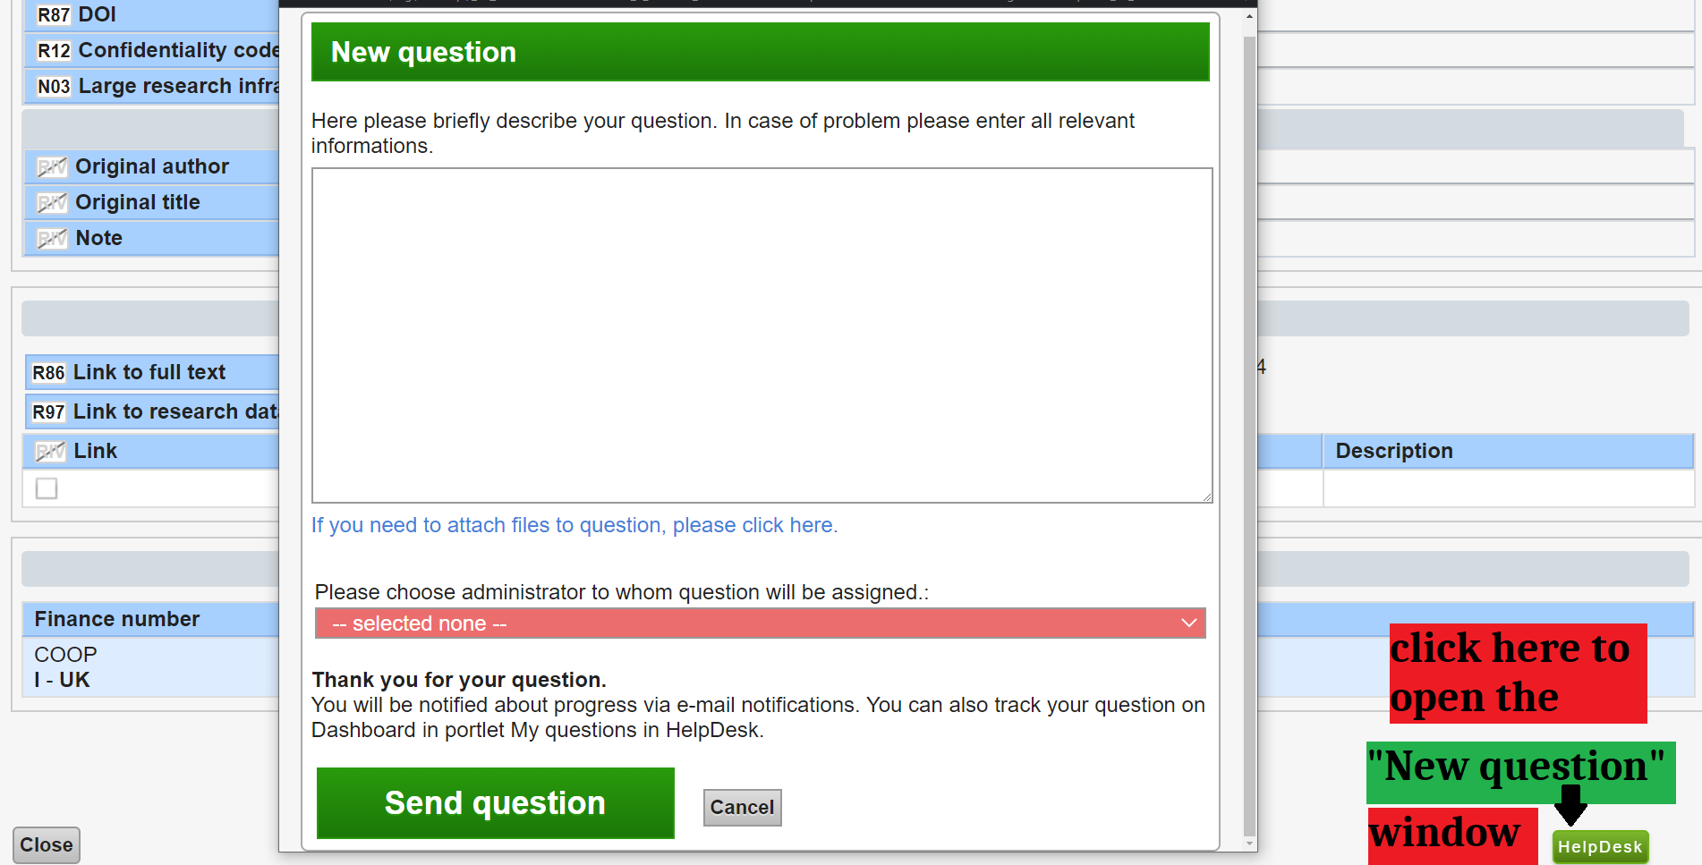
Helpdesk
Message / help request system
Also possible via email jakub.sindelar@fsv.cuni.cz
Ideally specify the Record ID / name of publication

Slide 25
Contacts and links
Department Administrator
Mgr. Jakub Šindelář
jakub.sindelar@fsv.cuni.cz
Faculty Administrator
Mgr. Michala Sošková
michala.soskova@fsv.cuni.cz
Links for more detailed info:
https://knihovna.fsv.cuni.cz/en/publishing-fsv
Rector´s Directive No. 40/2021
https://knihovna.fsv.cuni.cz/en/publishing-fsv/predatory-publishing
Personal research identifiers:
https://knihovna.fsv.cuni.cz/en/publishing-fsv/personal-identifiers
ORCID registration is free and is done at https://orcid.org/

